Slide 1
Introduction to Robotics: Mechanical Principles
Adam Watts
Engineering Physicist
Accelerator Division

Slide 2
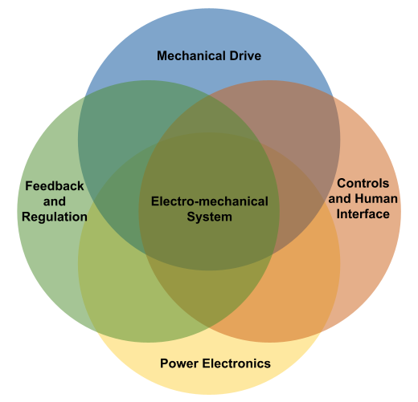
Robotics and Mechatronics
More than the sum of its parts, electromechanical systems are a multi-disciplinary application of several related fields.
The related engineering discipline is known as ``Mechatronics’’, coined in 1971 to describe the field that combines electrical, electronic, mechanical, computer, and systems control engineering.
Electromechanical systems rely on electrical power systems rather than hydraulic, pneumatic, or internal combustion. Electromechanical systems are the focus of this talk.
Robotics is a sub-field of mechatronics, dealing with general-purpose systems that can be re-programmed or automated to perform complex tasks.

Slide 3
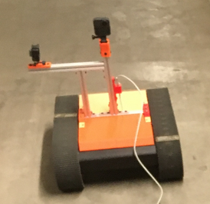
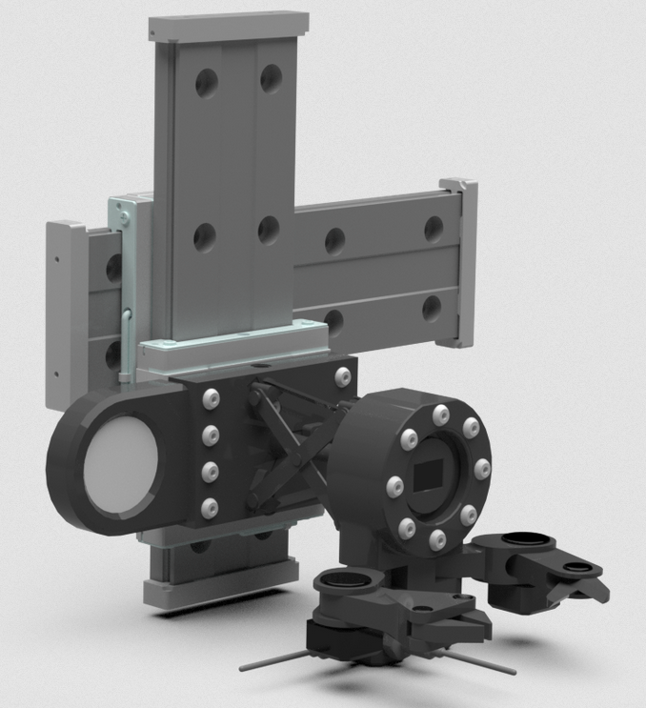
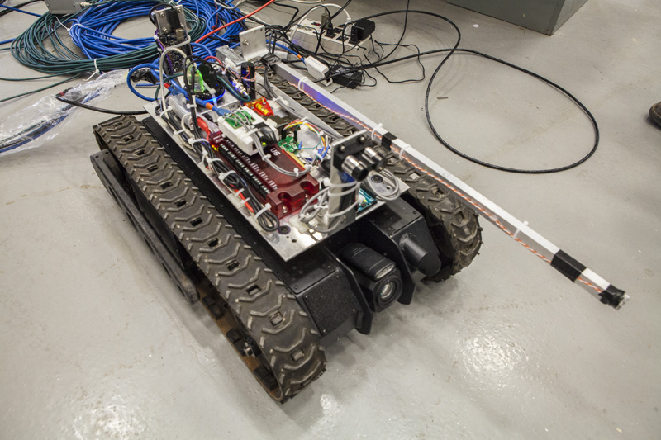
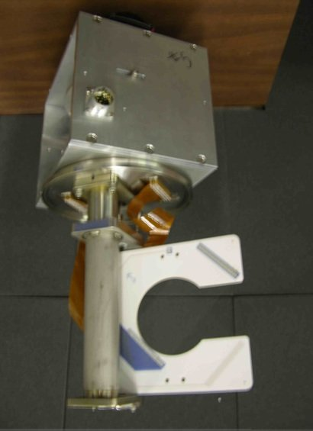
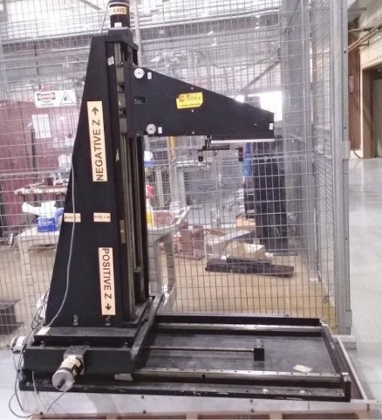
Robotics at Fermilab
Mechatronic systems are useful in the operation of particle accelerators:
Automate tedious tasks
Job-site setup
Ordering/sorting material
Radiation survey
Inspection
Perform tasks that are too dangerous or difficult for humans
Tasks in high-radiation, oxygen deficient, confined space, or other hazardous areas**
Tasks that require very precise movements and tooling
Tasks that put humans at risk of injury due to heavy lifting or repetitive stress
Tasks in areas too small or convoluted for humans to fit
Allow systems to move in/out of beam path during operation of accelerator
Positioning of movable instrumentation such as multi-wire detectors
Precise motion control of collimators, beam-stops, beam-splitting septa
** See Argonaut project, robotics in liquid Argon!
Fermilab Robotics Initiative https://ad.fnal.gov/robotics/

Slide 4
Mechanics Principles

Slide 5
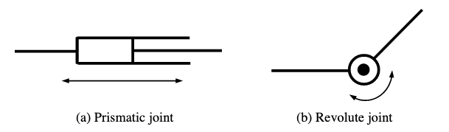
Joints and Linkages
A joint is a mechanical, movable connection between two rigid bodies in a mechatronic system.
Two fundamental joint types, or “joint primitives”, are the prismatic and the resolute joint.
The prismatic joint provides linear translation, and the revolute joint provides angular translation, between the two rigid bodies.
Actuators drive the motion of the joint with a mechanical force. A linear actuator can drive a prismatic or a revolute joint, and a rotational actuator can also drive a prismatic or revolute joint, depending on the type of linkage between joint and actuator. More examples of actuators and linkages are shown later in this talk.
Source: Harry Asada, and John Leonard. 2.12 Introduction to Robotics. Fall 2005. Massachusetts Institute of Technology: MIT OpenCourseWare, https://ocw.mit.edu. License: Creative Commons BY-NC-SA.

Slide 6
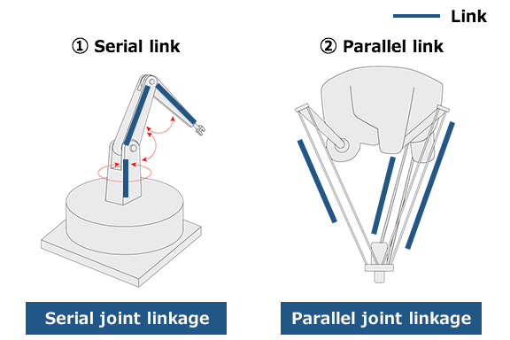
Serial and Parallel linkages
A linkage, or simply “link”, is a mechanical, movable connection between two rigid bodies in a mechatronic system. Serial linkages are the connection of successive joints one after the other. Parallel linkages connect joints all starting and ending at the same points.
Serial linkages tend to be more common in robotics, as they are simple to design, model, and build.
Parallel linkages have the benefit of increased strength, at the cost of increased complexity, and are typically reserved for heavy—load industrial robots.
To the left is an example of a manipulator built with:
A serial linkage of three revolute joints
A parallel linkage of three revolute joints
Source: Kawasaki Heavy Industries, https://robotics.kawasaki.com/ja1/xyz/en/1804-03/

Slide 7
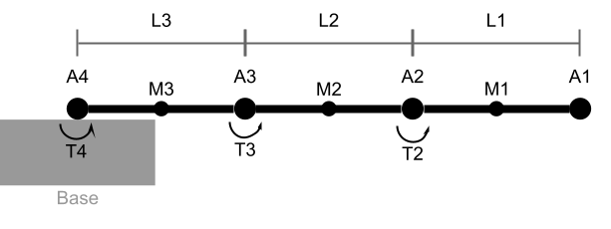
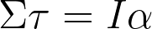
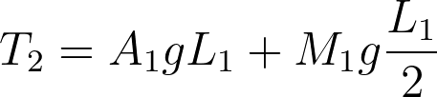
Static Torque
For a mechanical system composed of revolute joints, like the robotic arm example shown below, an important part of the design process is to compute the torque required for each actuator. The example arm is fully-extended perpendicular to gravity, which requires the maximum actuator torque.
Static torque is required to hold the arms at a fixed position against gravity. Torque is defined as a force acting over a distance away from the point of rotation, tangent to the rotation.
To compute the required static torque, we make use of the rotational version of Newton’s Second Law, where the sum of the torques in a system equal the moment of inertia (rotational mass) multiplied by the angular acceleration (which is zero for the static scenario). Therefore, the required holding torque of each actuator is equal to the torque applied by gravity on that segment of arm.
Source: http://hyperphysics.phy-astr.gsu.edu/hbase/torq.html - torq

Slide 8
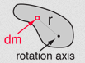
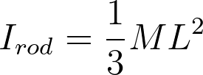
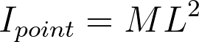
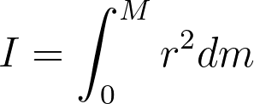
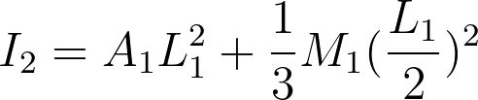
Dynamic Torque
Dynamic torque is required to accelerate the arms up to the desired speed. The total torque requirement of each actuator is therefore the static plus the dynamic torque. We again make use of the rotational variant of Newton’s Second Law, but this time the angular acceleration is non-zero, determined by the performance requirements of the arm.
Moment of inertia is the effective rotational mass about an axis of rotation. To compute the moment of inertia, approximate each arm segment as a simple rod of uniform linear density, and each actuator as a point mass. While moment of inertia is defined as an integral, it is also well-defined for simple geometric objects.
Source: http://hyperphysics.phy-astr.gsu.edu/hbase/mi.html#mi

Slide 9
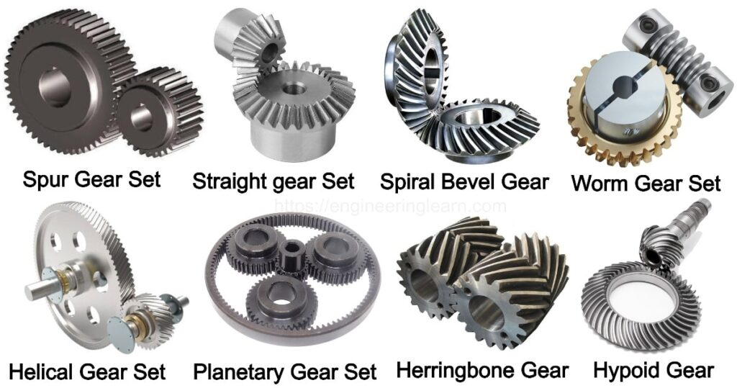
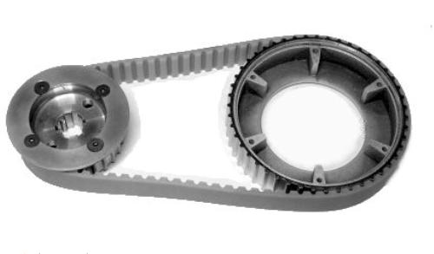
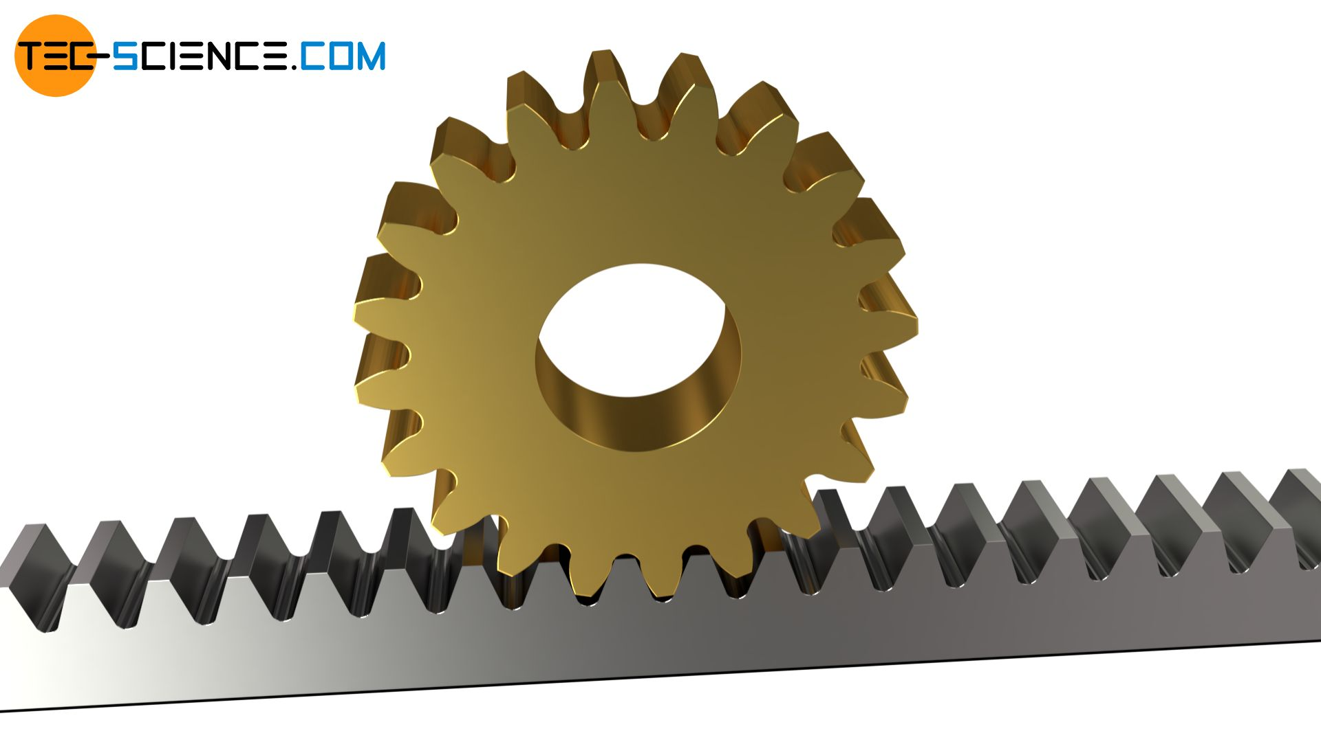
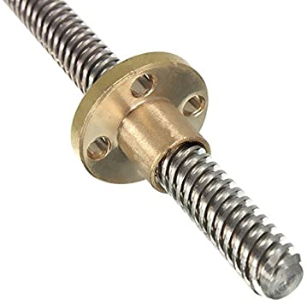
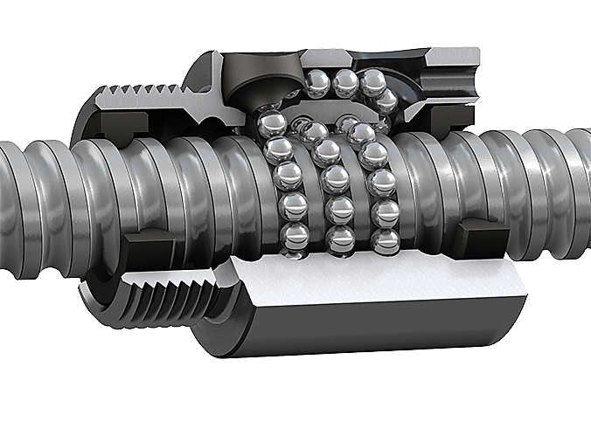
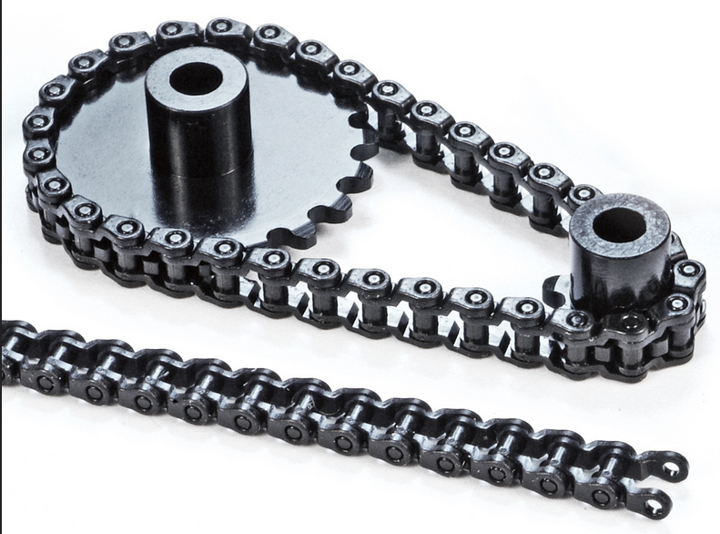
Common actuator types
While not an exhaustive list, below are a sample of common actuators to make use of the rotational torque provided by an electric motor. An actuator can change the direction, magnitude, and type of force from an electric motor. It can also affect “transmission” (i.e. translation) of torque from one point to another.
Various gear configurations
Rack and pinion
Toothed belt drive
Lead screw
Ball screw (cut-away)
Roller chain and sprocket

Slide 10
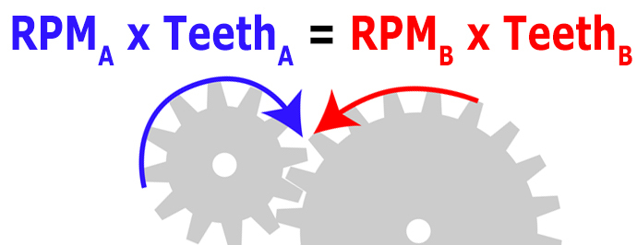
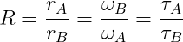
Gear ratios, torque, and speed
The basic equation that describes a gear system’s speed and torque as a function of its total gear ratio, or “reduction”, is:
R is the system reduction, ω the angular velocity (usually units of RPM), r the gear or pulley radius, and τ the torque.
For two gears with the same tooth spacing, the gear radius ration can be replaced with the tooth count ratio. This equation works for enmeshed (interlocked) gears, two wheels rolling against each other without slipping (friction drive), belt and pulley systems, as well as chain and sprocket systems.
Note that complicated gear systems like gearboxes, cycloidal or harmonic drives, and planetary gear systems can all be summarized by the basic R number. It is rare that you’ll need to compute R yourself, as the manufacturer should provide it.
Gear systems have some hysteretic behavior, where the same number of revolutions in one direction will not perfectly reverse those in the other direction; this behavior is known as “backlash”, and must be compensated by feedback and correction. Backlash is an inevitable characteristic of gear systems, and comes from the nonzero gap between gears to prevent binding and allow for lubrication.
Source: https://www.precisionmicrodrives.com/content/ab-024-introductory-gear-equations/

Slide 11
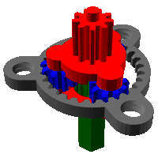
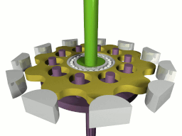
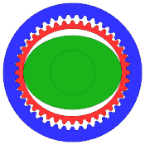
Exotic gear types
Epicyclic (“planetary”), cycloidal drive, and strain wave (a.k.a. ”harmonic drive”) gearing are more advanced gear techniques that can produce very high gear reduction ratios (>1:100) with little to no backlash in very compact packages. Planetary gear drives are relatively inexpensive in comparison to the other two, and readily available form even hobby-grade distributors. While commercially available, cycloidal and strain wave gear systems are very high-end and expensive, with significant performance increase commensurate to their high cost.
Source: https://en.wikipedia.org/wiki/Epicyclic_gearing
Source: https://en.wikipedia.org/wiki/Cycloidal_drive
Source: https://en.wikipedia.org/wiki/Strain_wave_gearing

Slide 12
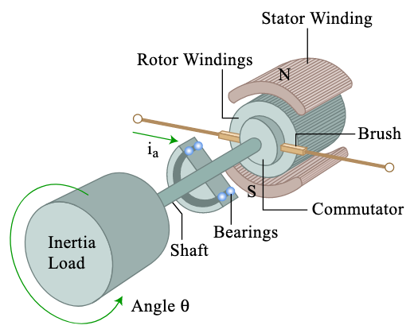
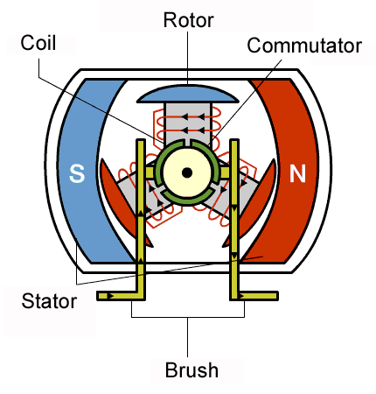
Brushed DC motor
The most basic version of an electric DC motor is the ”brushed” motor, whose parts are outlined below. A set of brushes physically touch the commutator to flow current through and create a magnetic field around the “rotor”, which is the part that spins. The “stator” does not rotate, but provides an opposing magnetic field (often by using permanent magnets) that applies torque to the rotor and makes it spin.
Brushed DC motors are relatively inexpensive and simple to control: apply a voltage per the motor’s specifications and the motor draws current to spin. Reduce the applied voltage to reduce the revolution speed, but at the expense of torque.
This torque reduction at low speed is a limitation of brushed DC motors that can be compensated with appropriate gearing. Another downside of these motors is that the brushes wear out over time due to friction. The brushes also tend to cause sparking and electromagnetic noise, and friction limits the maximum motor speed.
Source: Harry Asada, and John Leonard. 2.12 Introduction to Robotics. Fall 2005. Massachusetts Institute of Technology: MIT OpenCourseWare, https://ocw.mit.edu. License: Creative Commons BY-NC-SA.
Source: https://www.renesas.com/us/en/support/engineer-school/brushless-dc-motor-01-overview

Slide 13
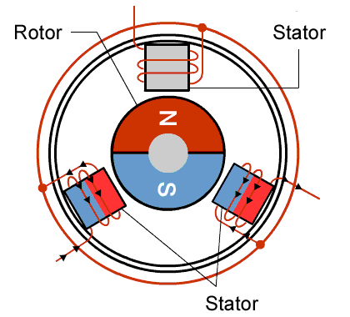
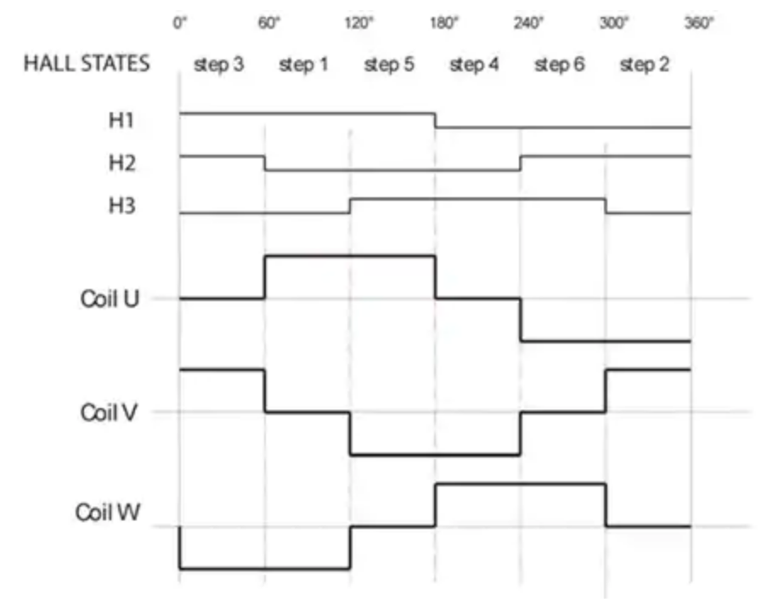
Brushless DC motor
As the name implies, brushless DC motors do not require a physical connection to a commutator to create the rotor’s electric field.
Rather, permanent magnets provide the rotor field, which is pushed by precise timing of the stator’s electromagnet polarities.
Brushless DC motors benefit from improved longevity as compared to their brushed counterparts, due to the lack of friction and wear of brushes. They are also more efficient and can provide more consistent torque for smaller motor size. They also produce much less electromagnetic noise due to the lack of brush sparking.
Disadvantages of brushless motors involve increased complication of wiring and control. The motor’s controller, often called an ”ESC” (Electronic Speed Controller), must energize the coils with precise timing, and for maximum efficiency must se ”hall effect” magnetic field sensors to synchronize the timing with the rotor’s motion.
Source: https://www.renesas.com/us/en/support/engineer-school/brushless-dc-motor-01-overview
Source: https://www.digikey.com/en/articles/an-introduction-to-brushless-dc-motor-control

Slide 14
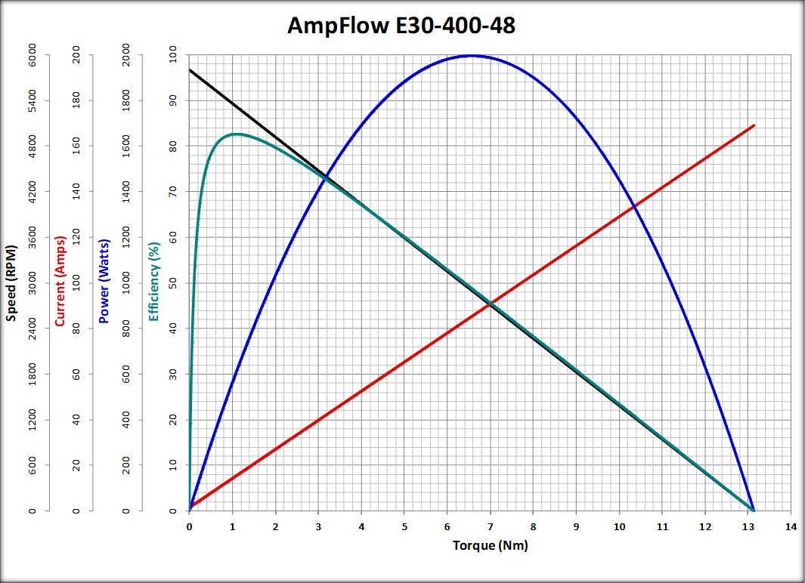
DC motors: Specifications
DC motor specifications:
Voltage rating
Current rating
Stall current and torque
“KV” rating**
Higher operating voltage means higher speed, while higher current corresponds to higher torque; neither should exceed the rated or max. voltage or current specifications from the manufacturer.
Stall torque is that required by a load to fully stop the motor’s rotor, at which point the motor will draw the stall current amount.
** Brushless DC motors often have a “KV” rating, which is no-load RPM speed per volt. Higher KV means a faster motor, at the expense of torque.
Source: Robotshop: AmpFlow E30-400-48

Slide 15
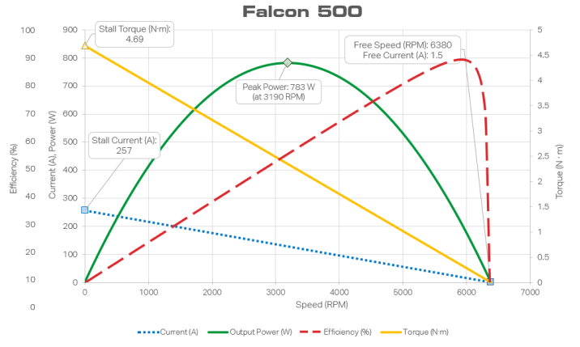
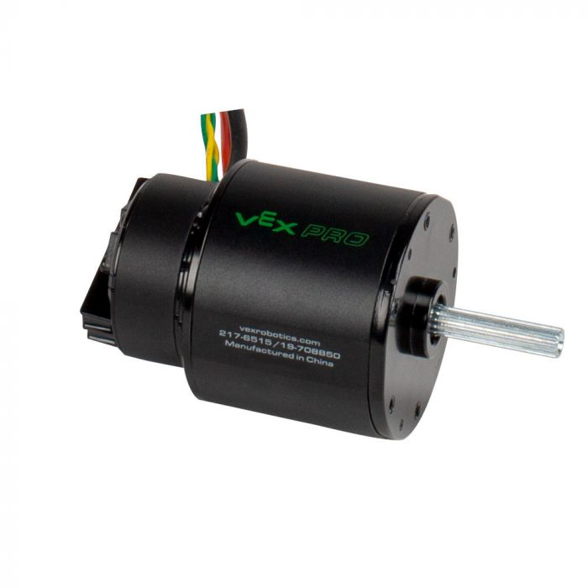
Brushless DC motor example
This high-torque brushless DC motor from Falcon is specified a bit differently, since it is marketed toward robotics competitions. No apparent KV rating, but company expects you to use their proprietary controller.
Battery In: 12V DC
Free Speed: 6,380 rpm (+/- 10%)
Free Current: 1.5A
Maximum Power: 783 W
Stall Torque: 4.69 N-m (41.51 in-lbs)
Stall Current: 257A
Mounting Holes: (6) #10-32 tapped holes on a 2" bolt circle
Max Voltage: 16V continuous
This motor includes a built-in encoder that measures the angular position of the rotor for precise feedback and control.
Source: https://www.vexrobotics.com/217-6515.html

Slide 16
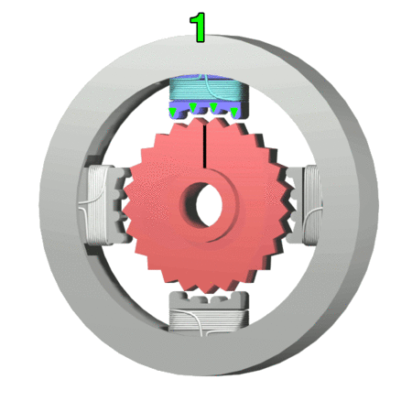
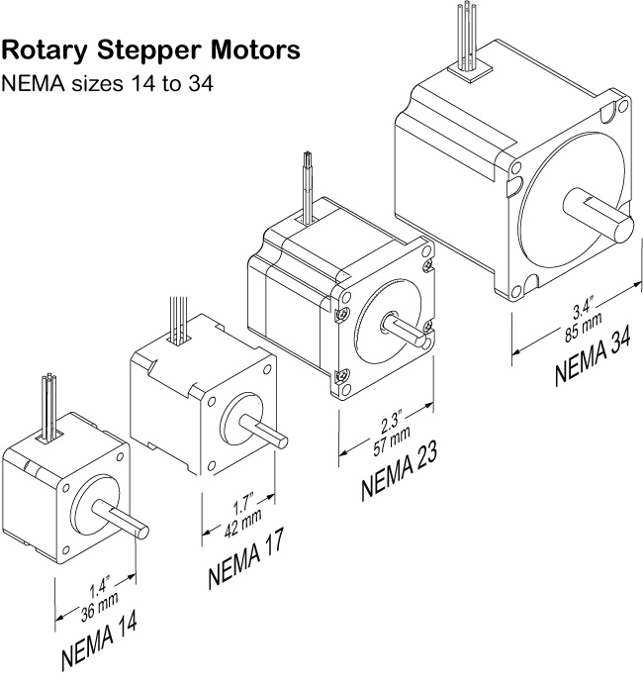
Stepper motor
Stepper motors are a type of brushless DC motor whose rotations are broken into discrete pieces, or “steps”. They are used more for precision angular positioning, rather than continuous high-speed running like regular brushless DC motors. It is important to note that while stepper motors have standardized sizes, i.e. “NEMA” ratings, this only specifies the size of the mounting holds on the motor frame, not the motor torque and electrical characteristics.
Stepper motors have the advantage that they can provide precision positioning without any feedback, i.e. in “open loop” control. Furthermore, stepper motors can maintain a position automatically without feedback, by drawing a “holding current” to keep the rotor fixed when not being pulsed.
Disadvantages of stepper motors are that they can miss steps if enough torque is applied to the rotor; in this case, counting steps may not be an accurate way to measure how much the load has rotated. The addition of feedback sensors such as encoders can mitigate this issue. Stepper motors also perform best at low speeds, and lose significant torque at high rotation.
Another factor to keep in mine with stepper motors is that they are always drawing current, even when not rotating (see “holding current” above). This is important to consider when working with mobile, battery-operated systems that user stepper motors.
Source: https://learn.adafruit.com/all-about-stepper-motors/

Slide 17
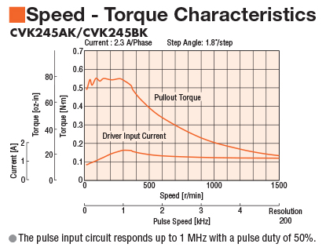
Stepper motors: Specifications
Stepper motor specifications
Coil current rating
Voltage rating
Holding torque and current draw
Coil resistance and inductance
Rotation angle per step
Unipolar or Bipolar (how many wires)
Torque and current draw vs. speed
“Pullout” torque is the maximum torque the stepper can provide without the potentially missing a step.
Driver voltage determines maximum speed (V=L*dI/dt, while current determines maximum torque. Steppers can be operated somewhat below rated voltage/current for extra safety and heat margin.
Source: https://www.orientalmotor.com/stepper-motors/technology/speed-torque-curves-for-stepper-motors.html

Slide 18
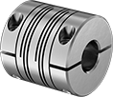
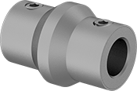
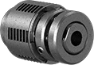
Motor couplers
Motor shaft couplers can provide extra safety between the motor and load; this can come from limiting the motor’s torque, disconnecting the motor from the load if the torque gets too high, or allowing for some mis-alignment between the motor and load shafts. For example, a torque-limiting coupler will protect a gearbox if its motor can provide more torque than the gearbox can handle.
This spiral-cut flexible coupler allows for parallel, axial, and angular misalignment between the motor and load shafts.
This coupler will shear and disconnect the motor from the load in an over-torque situation, destroying the coupler instead of the load.
This torque-limiting coupler will disengage the motor from the load in an over-current situation, re-engaging automatically when torque is reduced. This torque limit is adjustable.
Source: https://www.mcmaster.com/

Slide 19
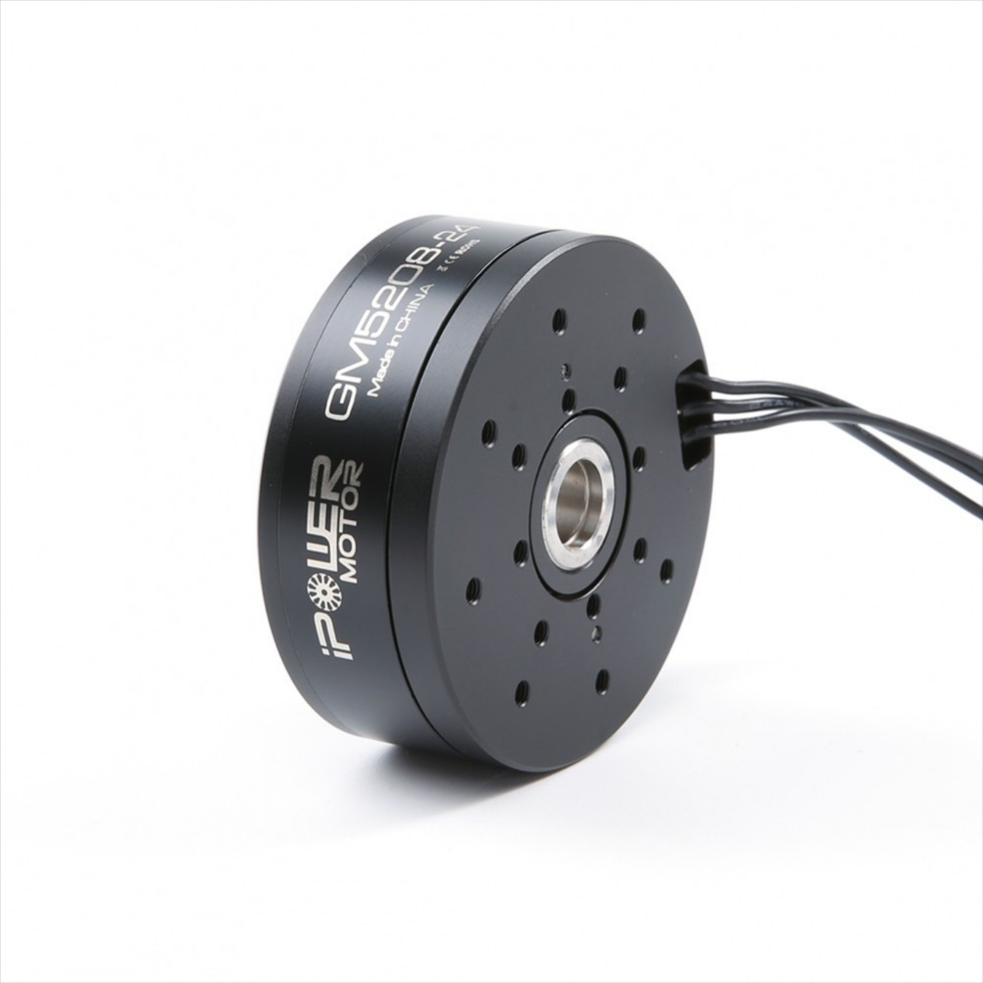
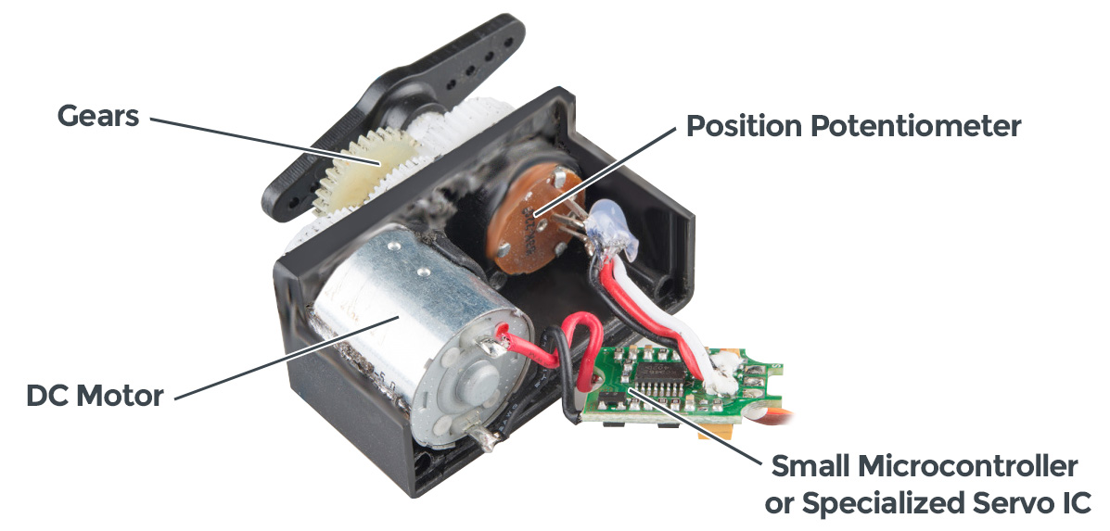
Commercial actuator example: Servo
A servo is a compact electromechanical system that provides precise angular or linear control of an armature using a simple DC motor, feedback position sensor, and some specialized electronics. Below is an example of a simple angular servo, cut away to demonstrate its internal parts. Servos serve a similar function to stepper motors, with some advantages and disadvantages by comparison.
Servos provide consistent torque across a wide rotational speed range and don’t tend to suffer from reduced torque at high speed like stepper motors. They also tend to run smoother with less vibration compared to stepper motors, but precise position control requires the use of feedback that needs periodic tuning and adjustment. In general, servos are more complicated and tend to be more expensive than stepper motors at the industrial-quality level, but are still very common from hobbyist suppliers.
Source: Sparkfun.com, “Servos Explained”. https://www.sparkfun.com/servos
Source: Realpars.com, “Servo Motors Advantages and Disadvantages”. https://realpars.com/servo-motors-advantages/
Source: https://www.robotshop.com/en/ipower-motor-gm5208-24-brushless-gimbal-motor.html

Slide 20
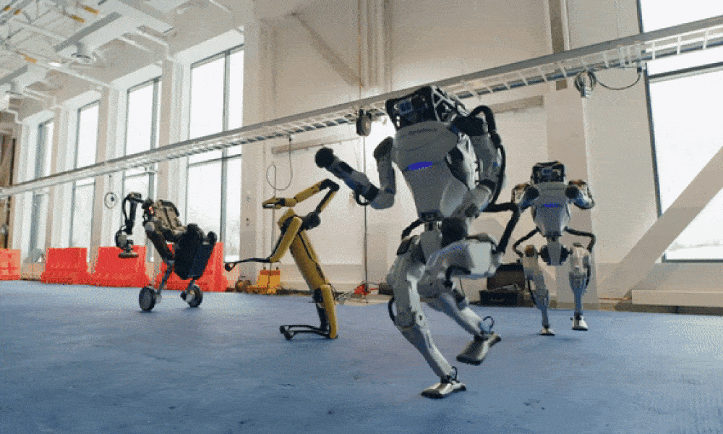
Robotics resources
MIT Open Courseware 2.12: Introduction to Robotics
Stanford CS223A: Introduction to Robotics
Northwestern University: Modern Robotics: Mechanics, Planning, and Control (free pre-print PDF)
Fermilab Robotics Initiative: https://ad.fnal.gov/robotics/
Thank you for your time!
Source: Boston Dynamics

